Slide 1
SAS Solar Phase 2
Stratton Carroll and Zach Denton

Slide 2
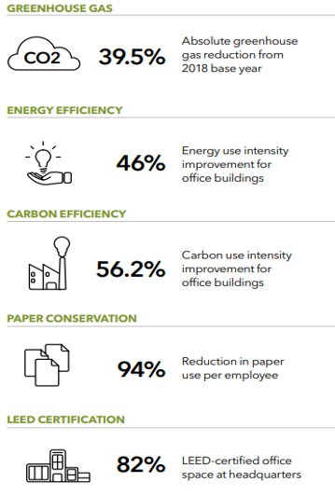
SAS Green Initiatives
STRATEGIC GROWTH THROUGH INNOVATIVE SUSTAINABILITY PRACTICES
Committed to 2050 net-zero carbon emissions
Aim to rely fully on solar energy

Slide 3
Context
SAS relies on solar and purchased energy to power ”Building A” at their head-quarters site in Cary, NC.
Solar Farm
12 acres
Energy use intensity (kWh/sqft) 11.4
Building A
419,924 square feet​
999 offices ​
700-seat capacity café​

Slide 4
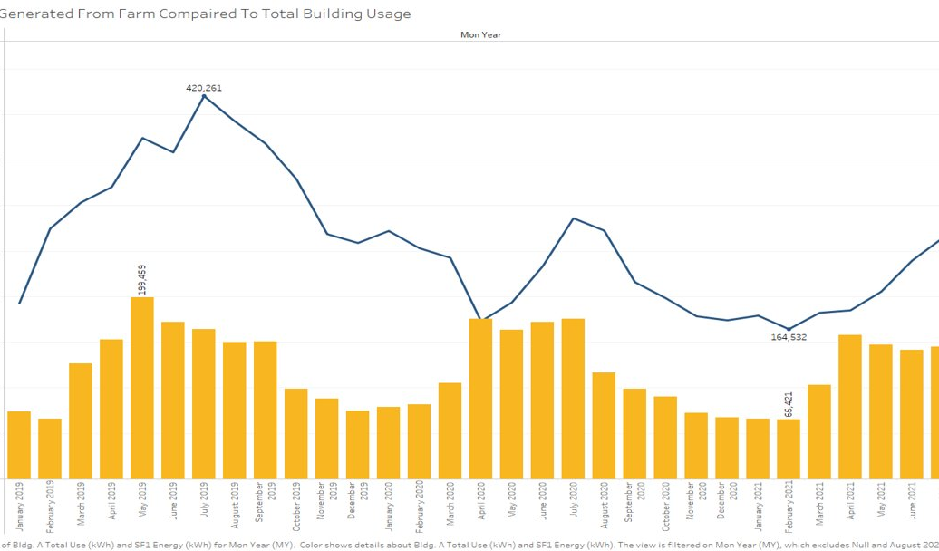
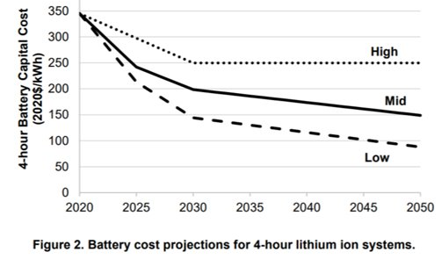
Phase 1 Recap
The solar grid does not generate enough energy to fully power Building A.
Not consistently generating enough excess power to warrant battery investment. ​
Solar Farm expansion > Battery Implementation.
Notes:
Adding more solar panels may have payback of 3-5 years​
Battery Prices are expected to drop 13% per year, so it makes economic sense to wait

Slide 5
Phase 2 Overview
Vision Statement
Team vision is to develop a predictive model for SAS that will enable the company to predict the solar energy output levels for their HQ building “A” solar farm, accounting for a variety of weather conditions. In addition, create an interactive dashboard for management to view the solar output in these different conditions.
Project Scope
Identify how to effectively power the building given specific conditions and establish excess/deficit solar production.
1. Interactive Dashboard
2. Predictive Models
Notes:
This leads us to phase II, where the outcome of this project is to create a predictive strategy for the solar energy forecasting problem to predict future power production so that SAS can effectively measure the solar farm energy output.
We will accomplish this through an interactive dashboard and predictive models.

Slide 6
Business Questions
What key attributes are best used to predict 24-hour ahead energy output?
How can SAS forecast future solar farm output to better understand how much energy will be pulled from the grid to supply the building?
Notes:
SAS is wanting to be able to better predict solar energy output which can be difficult due to its high dependency on short-term weather conditions.
We seek answers to what are the most significant attributes used in predicting next day solar farm output.
And how can SAS gain further knowledge on balancing solar farm output with grid pulled energy.

Slide 7
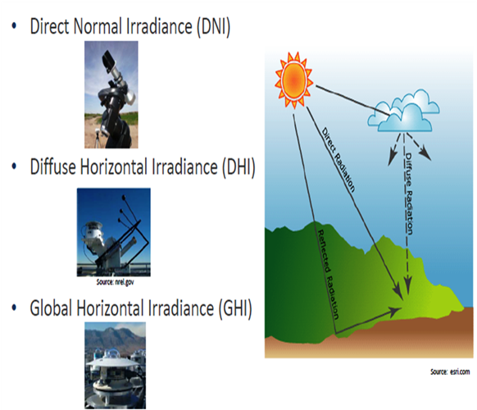
Data Management
The two different scraped weather data
Cary, NC Weather
Sunrise/Sunset
Daily humidity
Daily departure from normal average temperature
Daily precipitation levels
Daily sky conditions (low, medium, high altitudes)
Daily dew point temperature
Etc.
National Solar Radiation Database
Notes:
Zach: The data used was scraped from a local weather station in Car, NC. The data contains a variety of weather variable records from 2019 seen on the right.
The NSRDB solar resource data is collected by https://nsrdb.nrel.gov/ which is modeled using multi-channel measurements from geostationary satellites. The satellites were able to get the following measurements just miles from the SAS Solar Farm making for accurate results. The solar resource data that was used was Diffused Horizontal Irradiance (DHI), Direct Normal Irradiation (DNI), Direct Normal Irradiation (DNI), Global Horizontal Irradiance (GHI), Global Horizontal UV Irradiance, Solar Zenith Angle.

Slide 8
Interactive Dashboard
Significant metric used in model
Monthly time filter
Overall average comparisons
Notes:
The interactive dashboard shows significant variables from research on what effect solar output and the modeling I conducted.
The user can view the daily averages of each variable, average solar output, and energy pulled from the grid for a specific month.
These monthly averages can be compared against overall averages of the data.
Ill pull up the dashboard and walk you all through it.

Slide 9
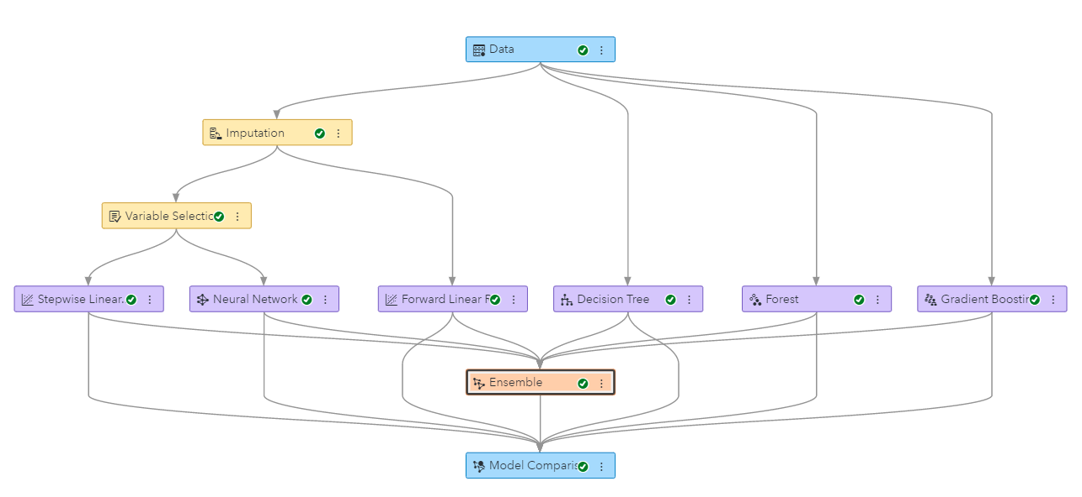
Modeling
SAS Viya
Performance Autotuning
Ensemble

Slide 10
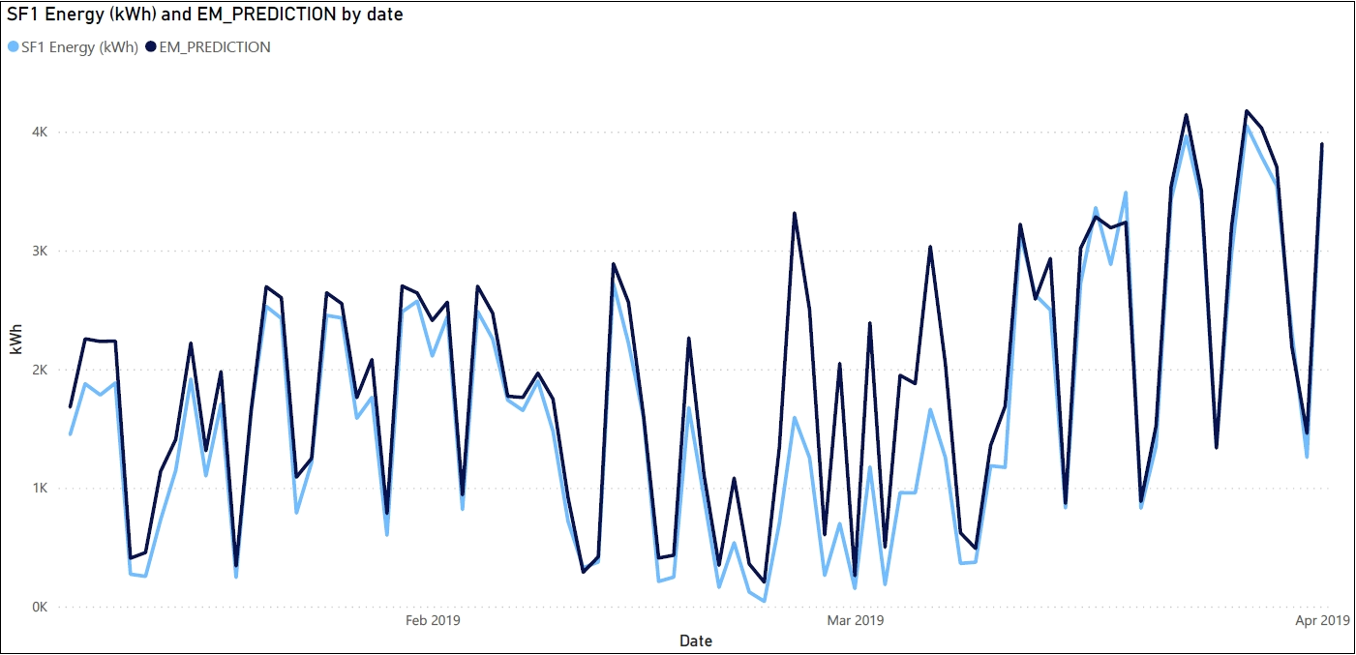
Modeling Results
Daily Solar Output: ~3000 kWh
RASE: 369.89

Slide 11
Deployment
Predict next day solar output.
Compare to energy pulled from grid.
Model can be implemented into other SAS solar farm locations.
Notes:
This package we created enables SAS to determine next day solar energy production and intern will allow them to better understand grid energy expenses.
The model can also be scaled to other locations with solar farms for the same purpose at their headquarters branch.
We recommend that SAS utilize the National solar database.

Slide 12
Thank You!
Questions?

